Slide 1
To replace with my own drawing

Slide 2
CSS143 Computer Programming (II)

Slide 3
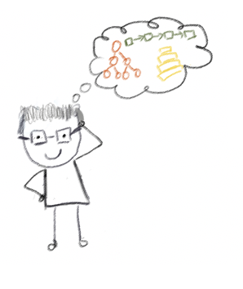
Lecturer
Peng Du
High performance computing
Matrix Factorization, etc
Cloud computing
Kubernetes, docker, etc.
Teaching
CSS 342 & CSS 143

Slide 4
Class Info
Syllabus
https://github.com/pdgetrf/CSS143B-2020Fall/blob/master/README.md
Canvas
Only used for major notification and publishing grades
Discord
Invite: https://discord.gg/tQy6tZg
Email:
Almost never checked

Slide 5
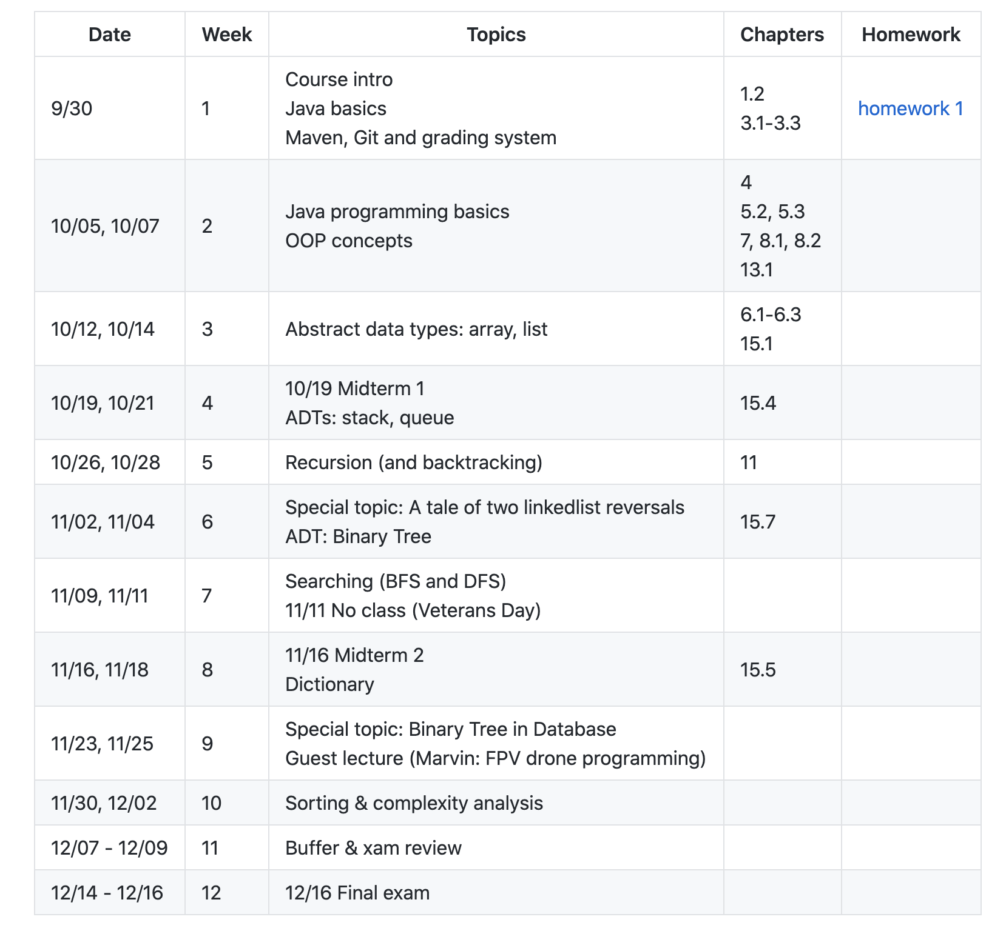
Class Info
subject to change
https://github.com/pdgetrf/CSS143B-2020Fall
How do I know though?

Slide 6

Class Info (the fun stuff)
Special topic: A tale of two linkedlist reversals
Special topic: Tree Application in Database
Guest lecture by @mbcfpv about FPV drone programming
(tentative) Guest lecture about Note taking and Communication

Slide 7
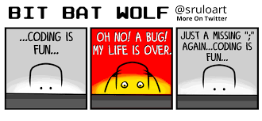
Class Expectation
After this term, you will
Be confident writing code in Java with cool tools such as Intellij, Junit, Maven
Be confident with using source control tools Git and Github
Write clean code with solid tests
Have good understanding of data structure such as array, hashtable, list, tree
Understand how to compromise between time and space complexity
Have solved many technical problems commonly asked during interview
Have written your own text search engine (Watch out! Google!)
(hopefully) Have fun and know whether CS is what you like!

Slide 8

Homework, Tests, Exams
Weekly homework
15-min Quiz, open book, mostly coding question
2 midterms (10/19 & 11/16)
1 Final (12/16)
No late assignment will be accepted
Exception is very very rarely given
No make-up exam

Slide 9

Plagiarism
School takes this VERY VERY seriously
It’s okay to get help from other people’s work/idea/code, but:
Give credit : “I was using […] for help in this homework”
Do not copy & paste (checked by grader)
Violation will be reported to department

Slide 10
Ramping up
“I’ve forgotten what I learned about Java”
Week 1
(this week)
Week 2
Week 3
Week 4
Brush up Java
Learn your IDE
Learn Git & Github

Slide 11
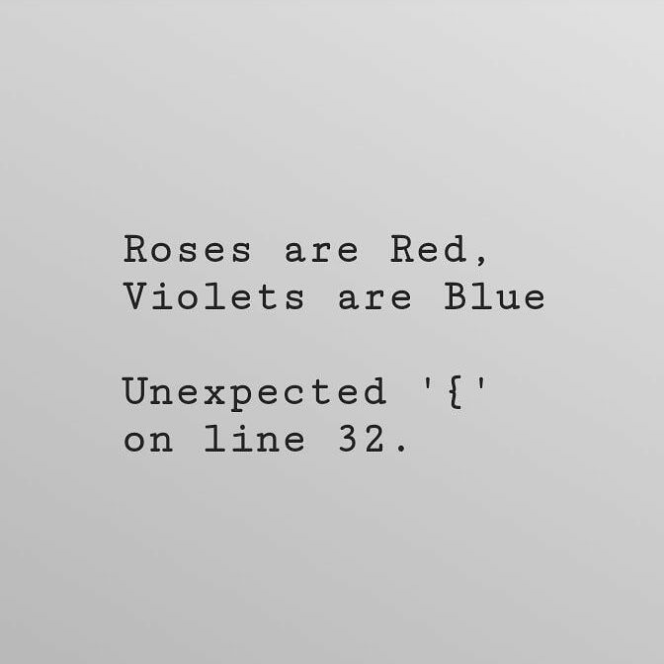
Tooling
OS:
Windows, Linux, Mac
IDE/Editor:
IntelliJ IDEA
Eclipse, Jgrasp, BlueJ, etc.
VIM, Emacs
Build Tool
Maven
Testing:
JUnit
Source Control
Git, www.github.com

Slide 12
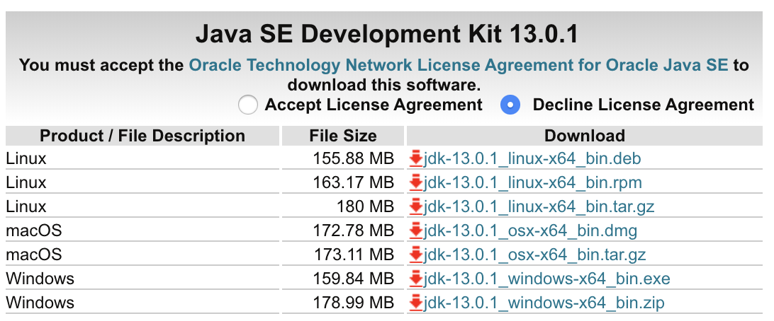
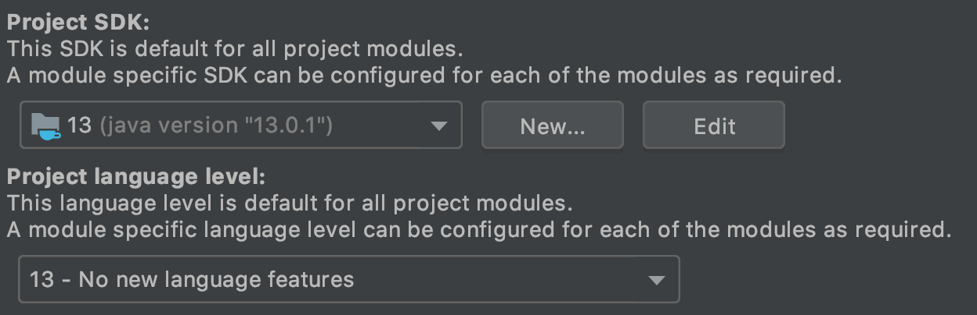
Java Development Kit
https://www.oracle.com/technetwork/java/javase/downloads/jdk13-downloads-5672538.html

Slide 13
What this class is
Problem Solving Using
Computer Programming
NOT programming languages

Slide 14
Computing Programming vs Programming Language
“Programming Language”
Loop
Class
Branching
Variables
Reference Passing
File I/O

Slide 15
Computing Programming vs Programming Language
“Problem Solving With Programming”
Data Structure
How to store data
Array, List, Tree, etc
Algorithm
Steps to do things
Recursion, Sorting, Searching

Slide 16
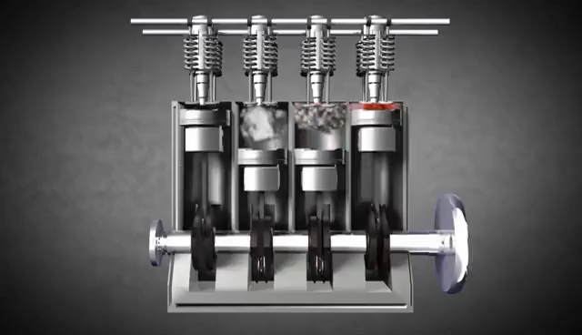
Computer Programming
Data Structure
3
0
1
2
3
4
1
5
0
1
2
3
4
0
2
4
6
Algorithm
Recursion
Searching
Sorting

Slide 17

Goals
Make the right choice
List vs tree?
Array vs HashMap?
HashSet vs TreeSet?
Write “solid” code
Humanly readable
Well tested
Easy to maintain

Slide 18



Slide 19
Guess the number in my mind
I have a number in my mind between 1 and 10
How many guesses?

Slide 20
Guess the number in my mind
I have a number in my mind between 1 and 100
How many guesses?

Slide 21
Guess the number in my mind
I have a number in my mind between 1 and 100,000
How many guesses?

Slide 22
Guess the number in my mind
Supposed each guess takes 1 second:
10
100
1000
100,000
Linear
10s
1m40s
16.7m
1d3h
Binary
3.3s
4.6s
6.9s
11.5s
Can we do better than binary search?

Slide 23
Guess the number in my mind
800
1
1000
1
800
1000
What if it’s not sorted?

Slide 24
Find 20 in this set
25
1
5
1
5
7
7
9
18
22
9
25
18
22
21
3
21
3
9
33
8
9
33
8
4
33
1
4
33
1
5
5
6
3
6
3
14
8
14
8
21
23
21
9
20
9

Slide 25
Find 20 in this set
25
1
1
1
3
3
4
5
6
6
7
8
8
9
9
9
14
15
5
20
21
22
25
33
33
5
18
21
7
9
18
22
21
3
9
33
8
4
33
1
Now we can binary search
5
6
3
14
8
but how fast can we sort?
but how do we sort?
21
9
20
How to store the data?
What if data keeps changing?

Slide 26
A Complexity Problem
Algorithm Complexity
“Complexity”
Time
Space
Usually time and space can be traded off with each other

Slide 27
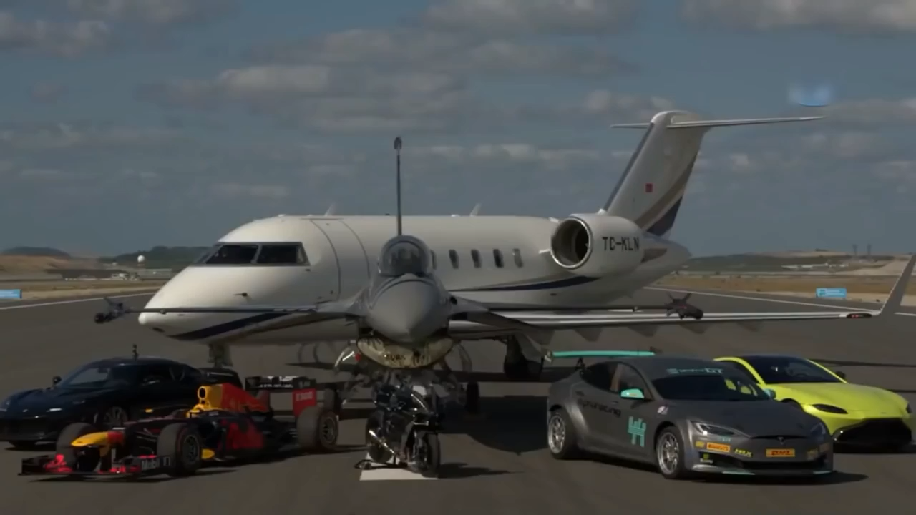
A Complexity Problem
Which one is fastest?
F1 by Redbull Racing Formula One
Motorcycle (Kawasaki Ninja H2R)
F16 Fighter Jet
Challenger 605 Private Jet
Aston Martin Vantage,
Lotus Evora GT430
Tesla Model S P100DL

Slide 28
A Complexity Problem
So….which one is the faster?
Bubble Sort vs Merge Sort
Recursion vs Iterative
Linear search vs binary search
Insertion in array and list

Slide 29
A Correctness Problem
“Does it work?”
“Does it work all the time?”

Slide 30

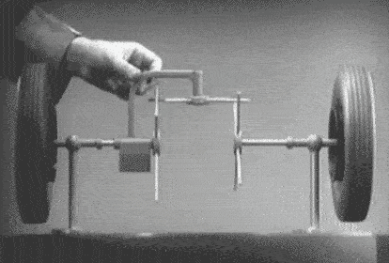
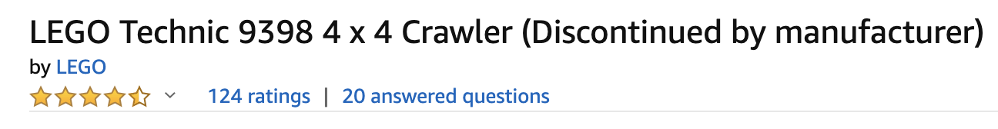
A Correctness Problem
Open Differential

Slide 31
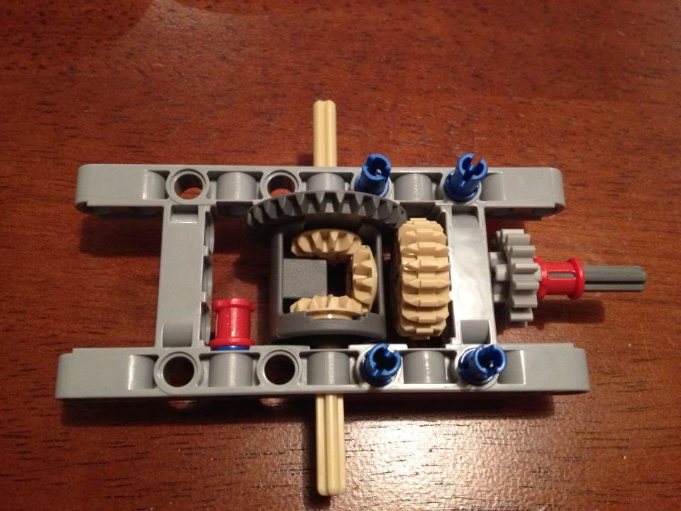
A Correctness Problem
Input:
Torque on drive shaft
Output:
Torque on wheel axles
How do you test this differential?

Slide 32
A Correctness Problem
Input:
Torque on drive shaft
Output:
Torque on wheel axles
Function:
Axles rotate independently
How do you test this differential?

Slide 33
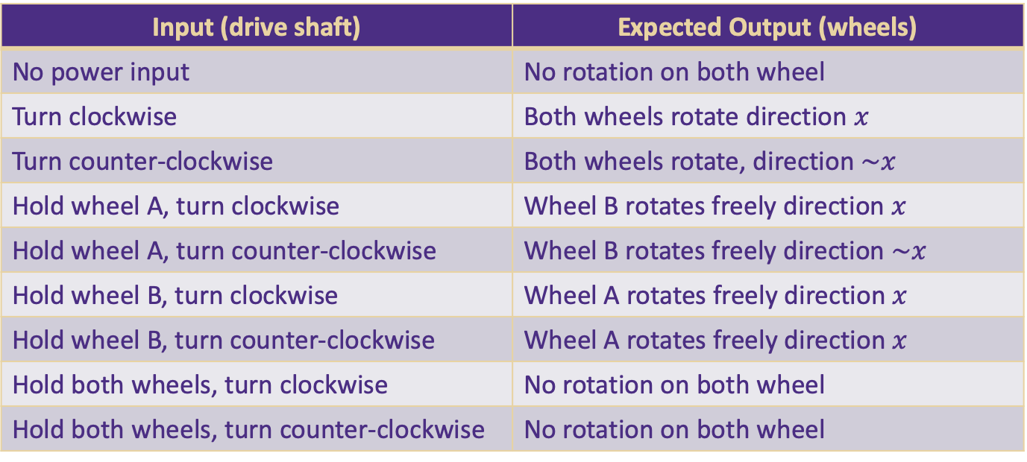
A Correctness Problem
Output: wheel A
input
Function To Test:
Axles rotate independently
Output: wheel B
Input (drive shaft) | Expected Output (wheels)
No power input | No rotation on both wheel
Turn clockwise | Both wheels rotate direction $x$
Turn counter-clockwise | Both wheels rotate, direction $\sim x$
Hold wheel A, turn clockwise | Wheel B rotates freely direction $x$
Hold wheel A, turn counter-clockwise | Wheel B rotates freely direction $\sim x$
Hold wheel B, turn clockwise | Wheel A rotates freely direction $x$
Hold wheel B, turn counter-clockwise | Wheel A rotates freely direction $x$
Hold both wheels, turn clockwise | No rotation on both wheel
Hold both wheels, turn counter-clockwise | No rotation on both wheel

Slide 34
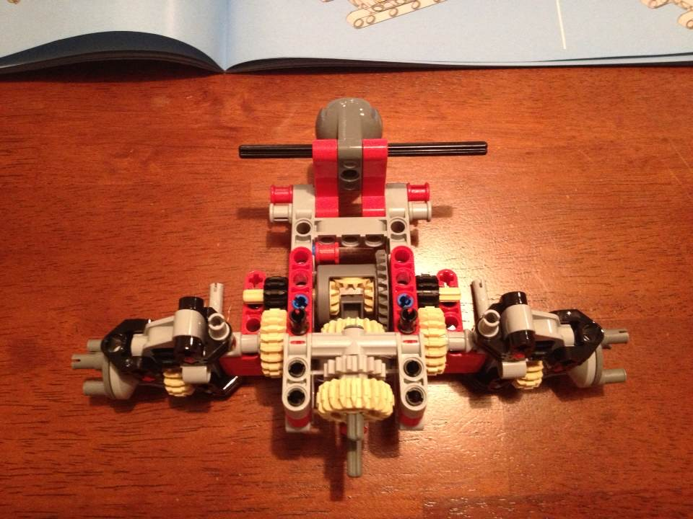
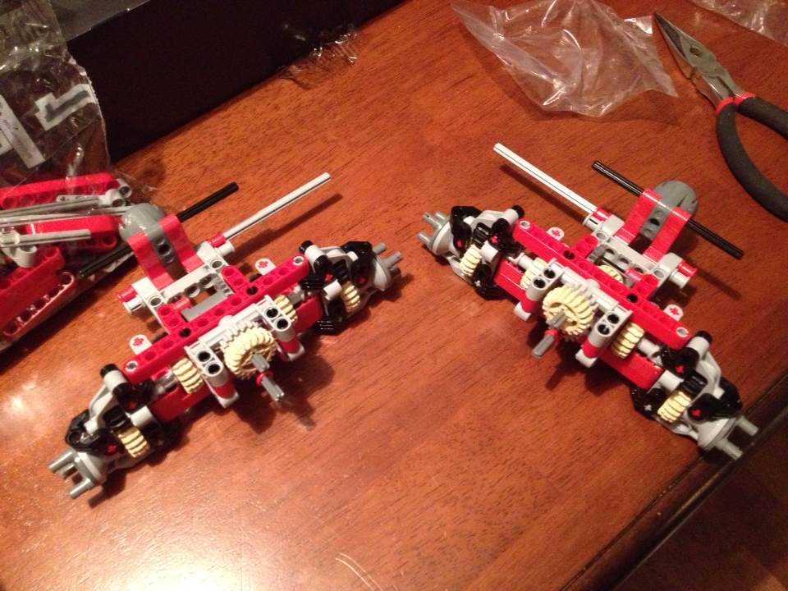
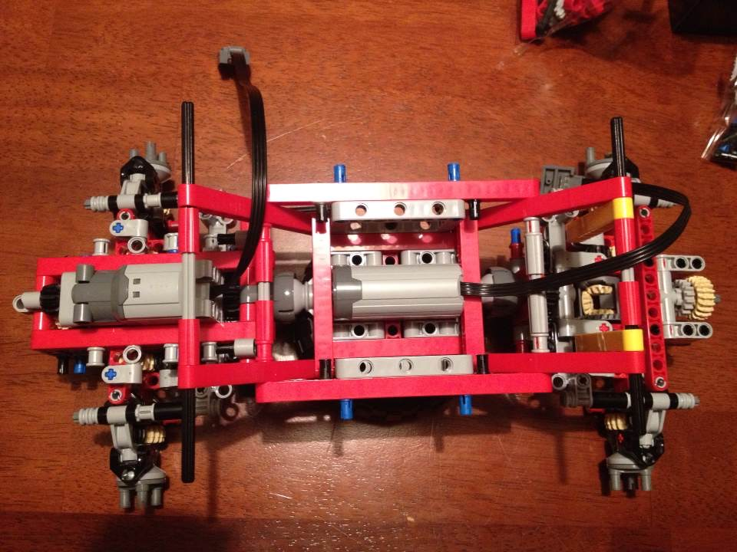
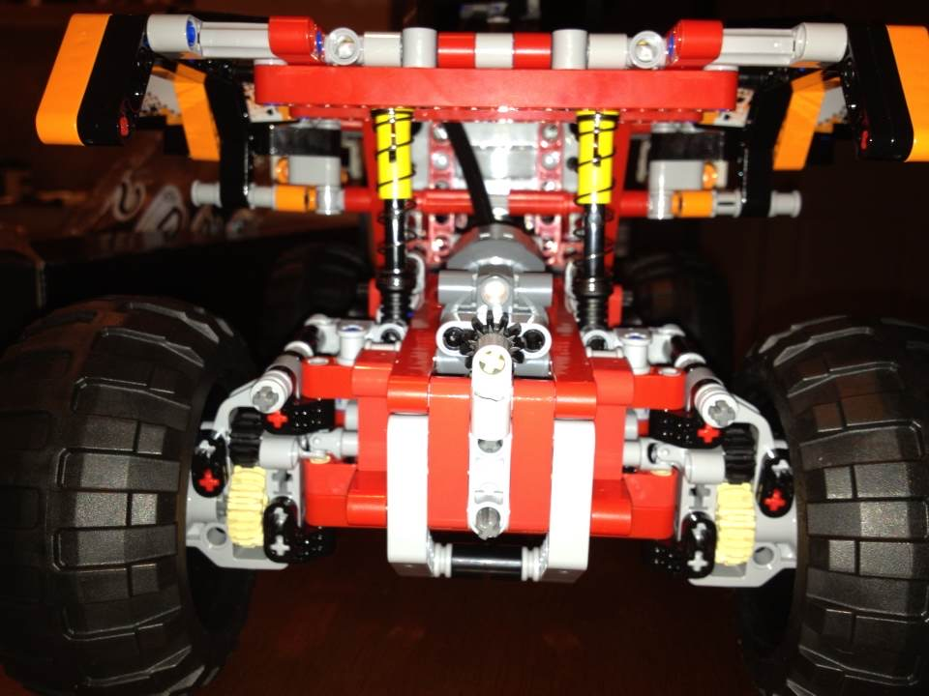
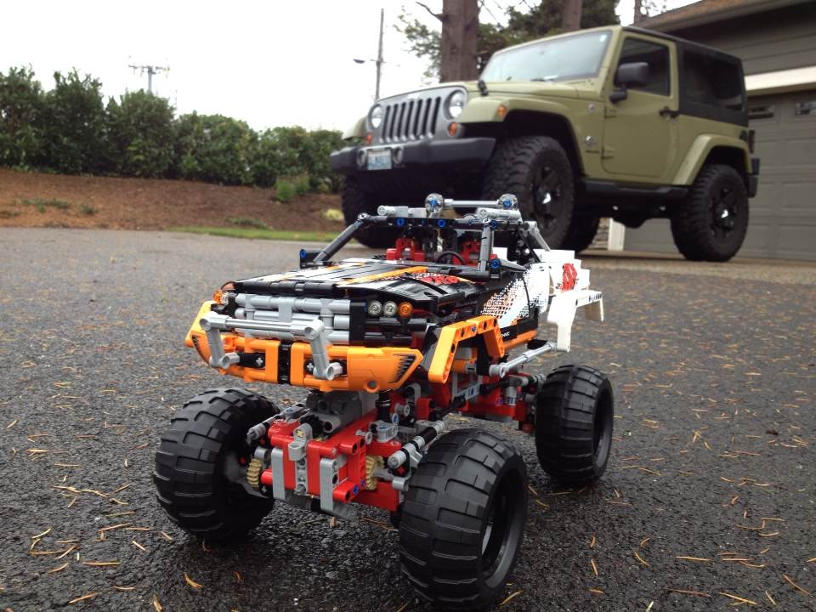
A Correctness Problem

Slide 35
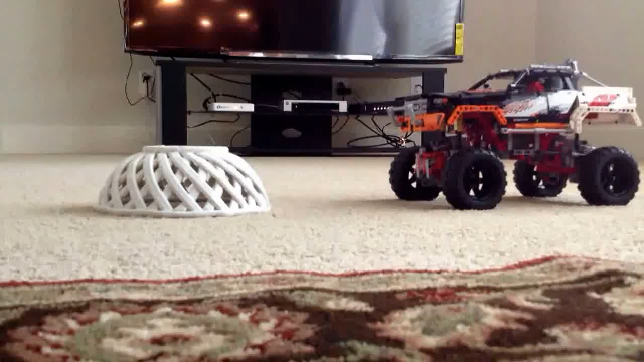
A Correctness Problem
Testing
Unit test
Integration test
Math Proof
Math Induction

Slide 36


Slide 37
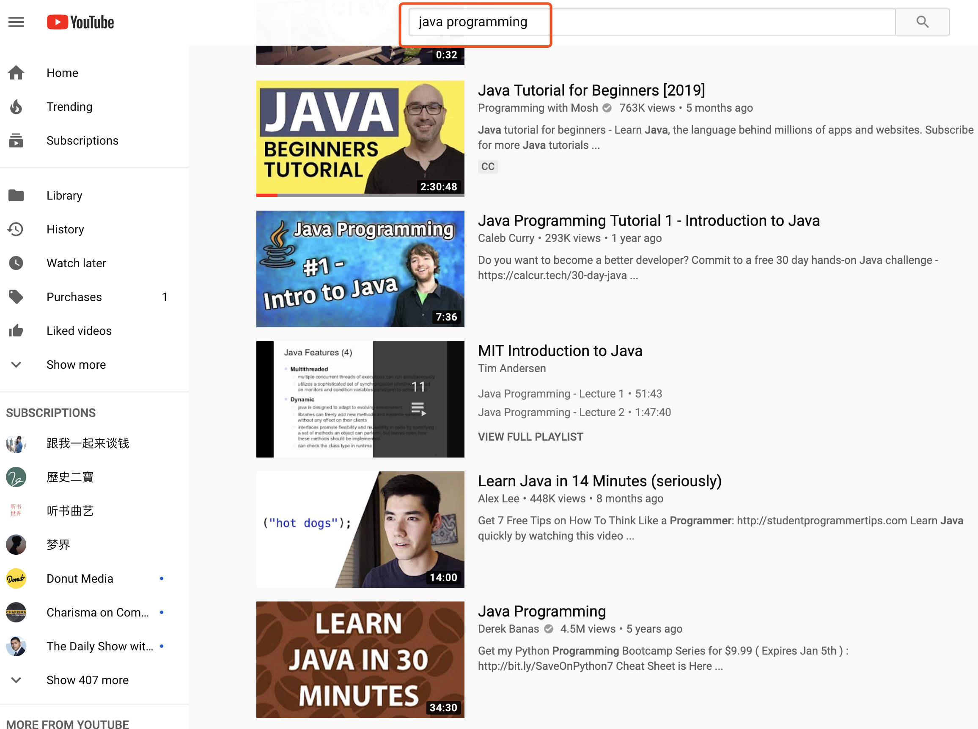
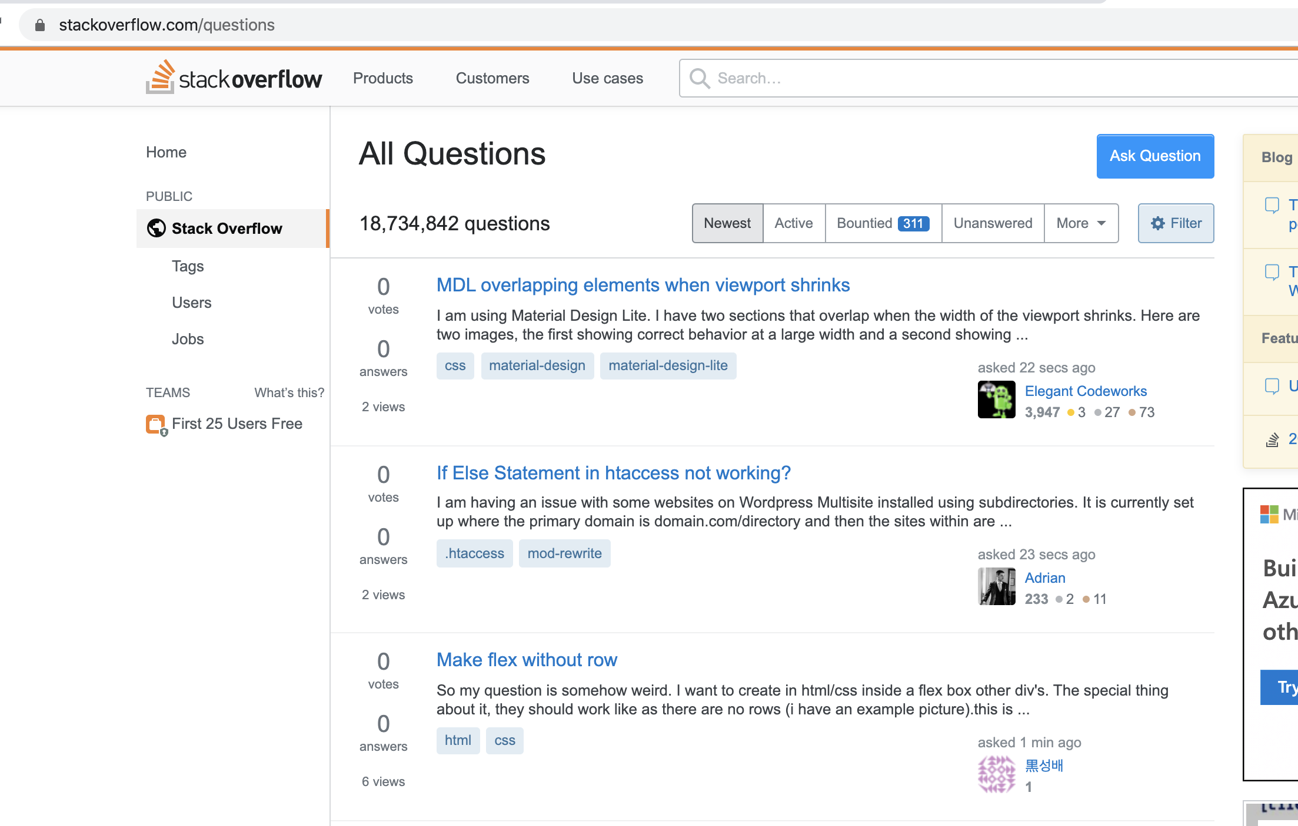

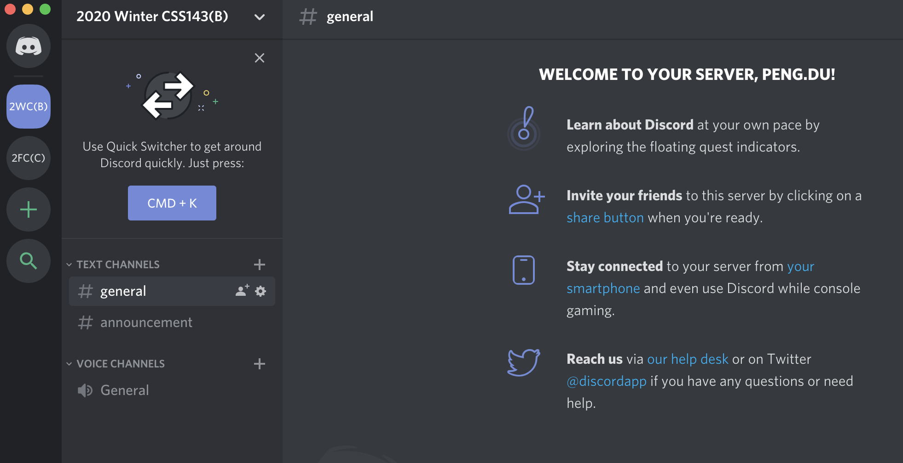
Tips For Success
Learn to Learn
Be resourceful
Be an independent learner
Academically mature
Ask proper question
“My code doesn’t work!”
“My code is giving … errors! I have tried …!”

Slide 38
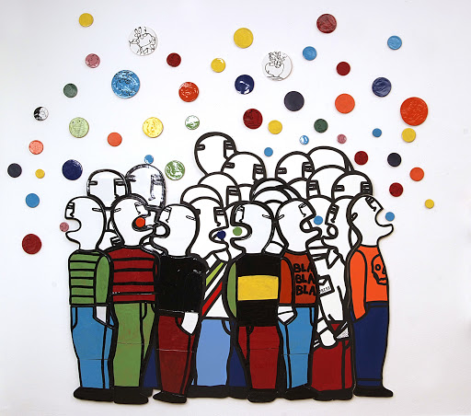
More on Communication
Use the discord channels
Discord Invite: https://discord.gg/tQy6tZg
Study group
Official office hour (1 hour after each lecture)
On Discord, specified hangout time
Start your own study group (3-5 people, online)

Slide 39

Tip On Success
Prioritize!
Write Code, lots of them!
Slow in, fast out!
Communicate!
Start everything early!

Slide 40
Tip On Success
“I do not know much about Java or programming, so I will attempt to read the whole textbook page by page before starting coding or homework”
“Don’t be a hero!”
Read just enough to write code
Write just enough code to pass tests
Then read more and code more

Slide 41
Tip On Success
3 days till homework due, you realized you won’t make it to the deadline because it’s more difficult than you think.
What would you do?
Panic and give up
B. Work on it quietly by yourself till last minute
C. Try to find code online and copy it and call it a day
D. Try to find code online, use it but also give it credit
D. Try to find solution online, use it but also give it credit
E. Get over the social anxiety and reach out to friends/instructor for help immediately

Slide 42
Tip On Success
“Homework is due tonight midnight. I’ll work till my code is perfect and submit at 11:59pm”
Submit early and refine frequently!

Slide 43

Parkinson’s Law
“Work complicates to fill the available time.”
Break down goals into smaller pieces of tasks
Define quantifiable “DONE”
Minimize overwhelm by prioritizing tasks.
Challenge yourself, e.g. set time limit.

Slide 44
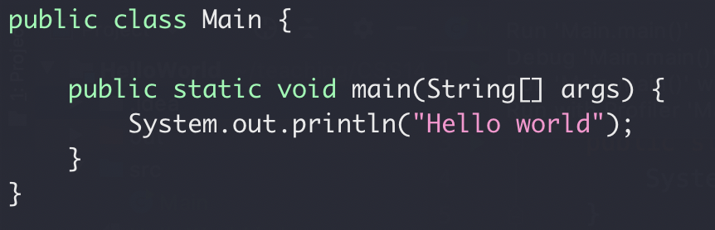
Hello World!
File name must match class name
Each program can only have one main() function
Main.java

Slide 45

Source Control
“My laptop crashed last night, and my homework is gone”
How do you safely store your code and track changes?

Slide 46
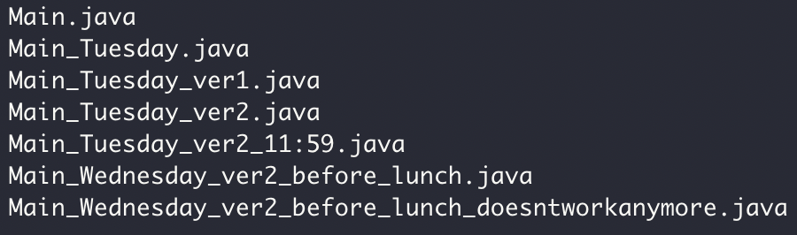

Source Control

Slide 47
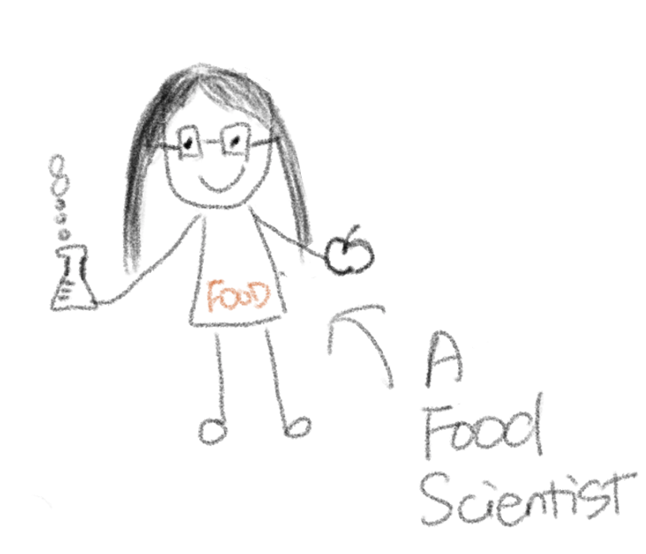
“everything needs version control!”
my wife

Slide 48


Source Control
Code version 1
Code version 2
Code version 3
“commits”
Code version 1
Code version 2
Code version 3
Code
……
Monday
Tuesday
Wednesday
Thursday

Slide 49
Source Control: “commits”
Task: draw a circle

Slide 50
Source Control: “commits”
Day 1
Day 2
Day 3
Day 4

Slide 51
Source Control : “commits”
Commit 1
Commit 2
Commit 4
Day 1
Day 2
Commit 3
Day 4
Day 3
Differ between commit 2 and commit 4:
Differ between commit 1 and commit 2:

Slide 52
Source Control: Branch
Commit 1
Commit 2
Commit 3
Commit 6
Merge, Commit 7
Master branch
another branch
Commit 4
Commit 5

Slide 53
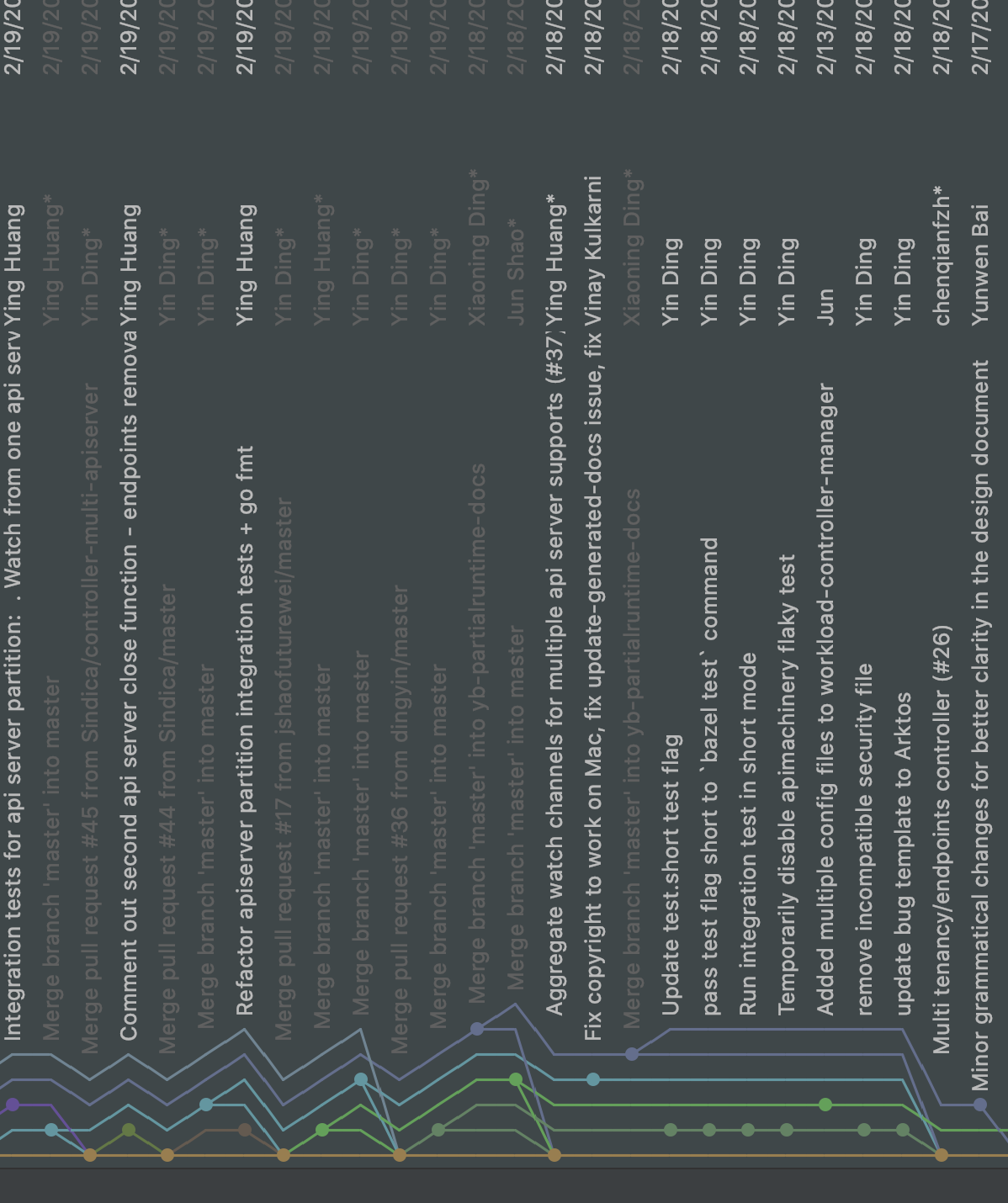
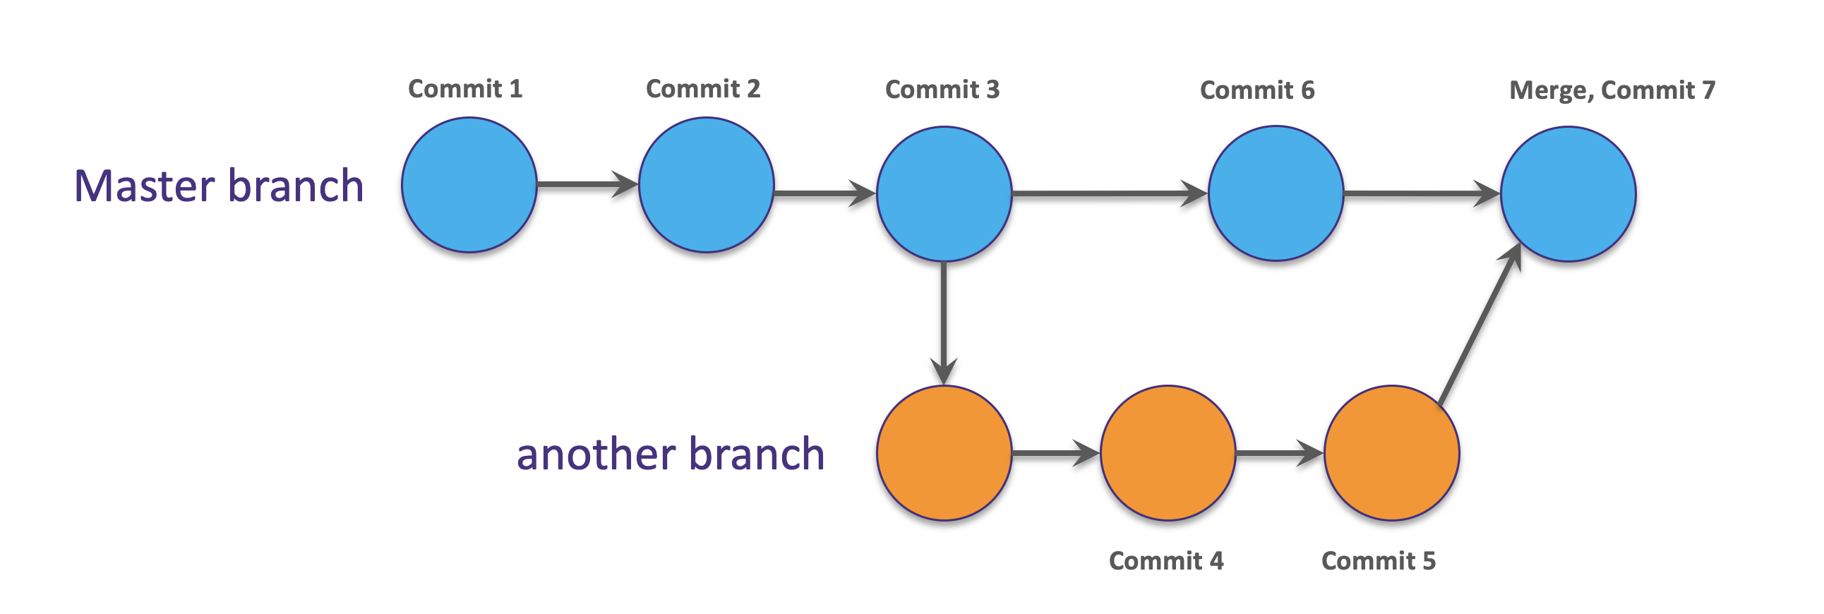
Source Control: Branch

Slide 54

Source Control:
Also watch https://youtu.be/mf2-MOl0VXY

Slide 55
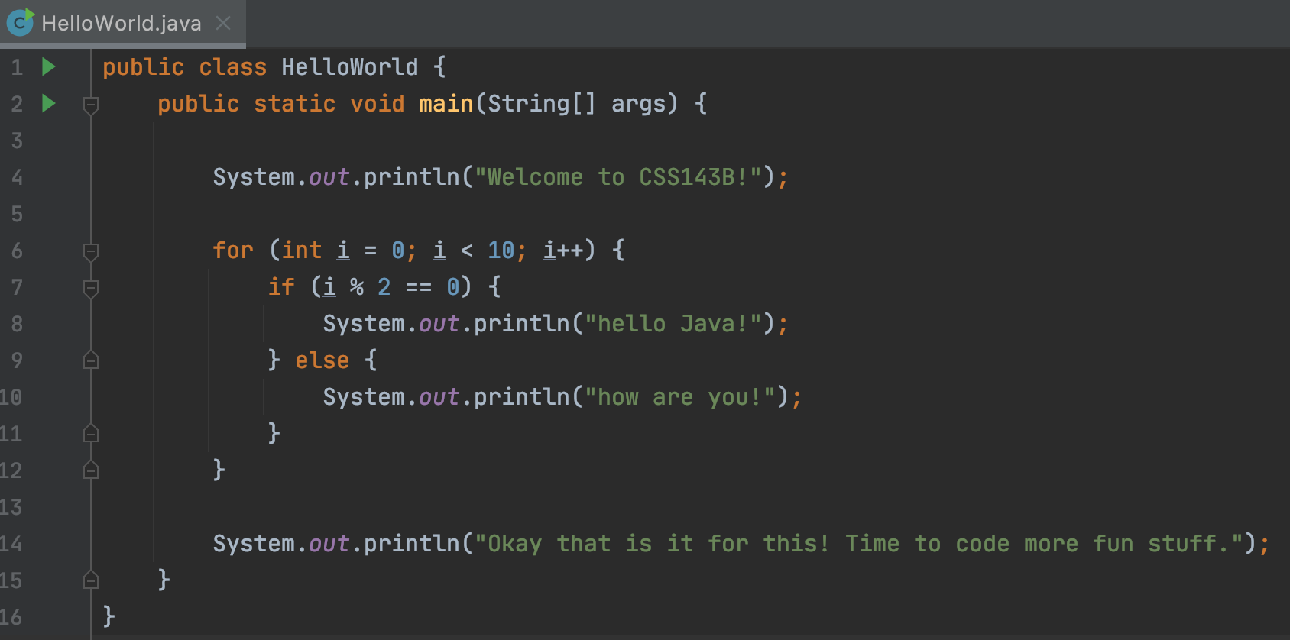
Demo:

Slide 56

Exercise 1:
Write code to find the max number in an integer array
Return the index of the max number
Convince yourself (and me) with tests that your code works correctly
12
12
1
7
18
10
3
0
1
2
3
4
5
6

Slide 57
Exercise 2:
Add your code (.java) to Git
Commit some changes
Create a new branch, and switch to it
Make some more changes
Commit changes
Make more changes

Slide 58
Next Lecture
Code-Along
Bring your computer with a working coding environment
Understand Git commits & branches
Have a Github account. Apply here if you don’t have one.

